Slide 1
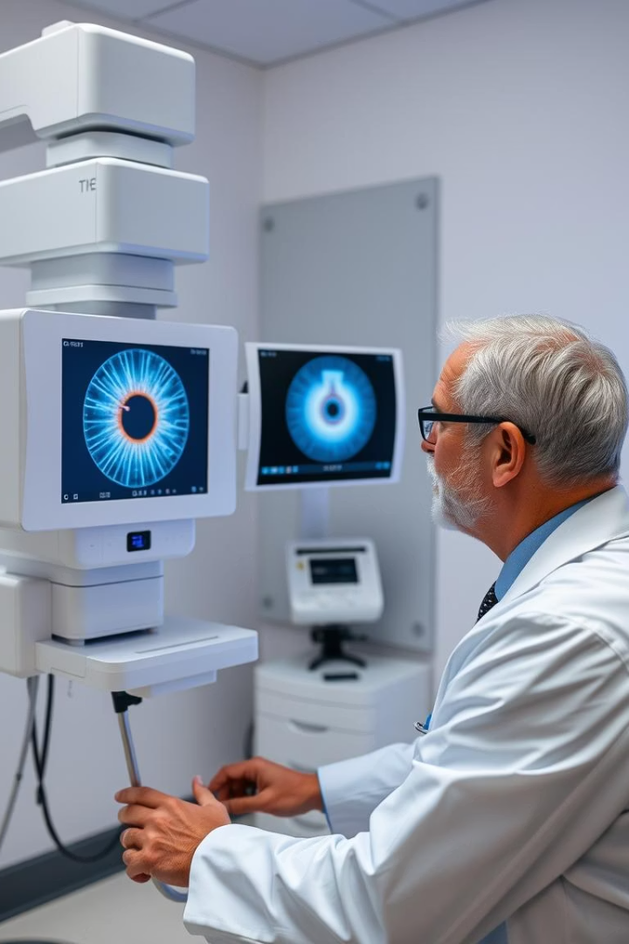
Ocular Disease Recognition
Netaji Subhas University Of Technology
Guddi Urf Aarti - 2022UCA1960
Suhani Yadav - 2022UCA1904
Pranshu Kumar - 2021UCA1889

Slide 2
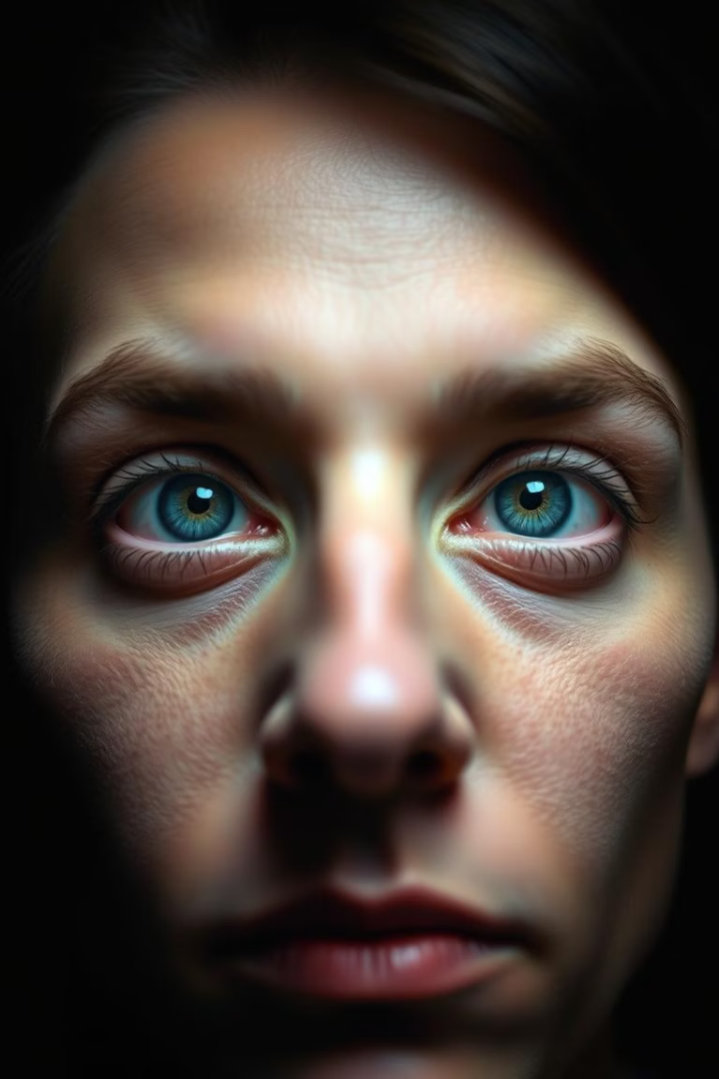
Problem Statement
Global Challenge
Preventable Cases
2.2 billion people have visual impairments globally.
Ocular diseases can be very severe and lead to blindness. Therefore, early identification of the disease can lessen the severity of the condition.
At least 1 billion cases could have been avoided with early diagnosis.
Our Approach
We have solved this problem using some Deep Learning models to predict whether an image belongs to Normal or Cataract category and also made a comparison among them.

Slide 3

Introduction
Increasing Ocular Disorders
Diagnostic Challenge
Project Aim
Ocular disorders have become more prevalent throughout time, with one of the causes being changes in human behaviour patterns brought on by technology and the creation of technological equipment.
The diagnosis of ocular pathology using fundus images is a significant difficulty in health care.
The aim of our project is to develop a combination of feature extraction methods and Neural Networks to recognize common types of visual disorders using the fundus images.
•Fundus photographs are ocular documentation that record the appearance of a patient’s retina.

Slide 4
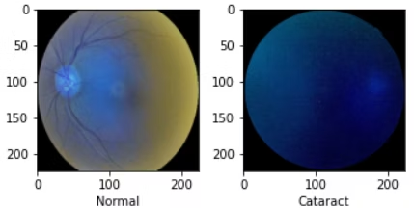
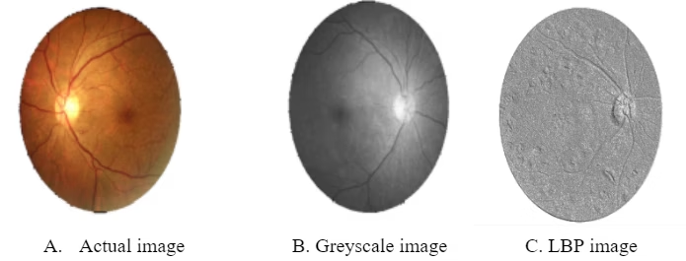
Dataset
Size and Scope
Feature Extraction
Dataset
7000 images with 5000 for training, 1000 for testing.
Using Local Binary Pattern (LBP) to extract image features.
This dataset contains various types of eye images such as Diabetes, Glaucoma, Cataract, Related Macular Degeneration, Myopia, Hypertensive Retinopathy and other ones.
Includes Diabetes, Glaucoma, Cataract, Myopia, and more.
LBP captures texture by encoding neighbourhood pixel patterns.

Slide 5
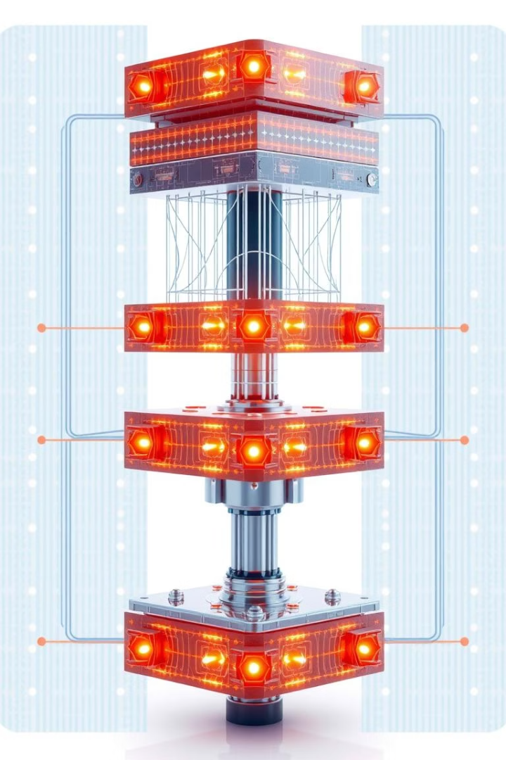
Models
VGG19
ResNet50
It is a convolutional neural network trained on a subset of the ImageNet dataset, a collection of over 14 million images belonging to 22,000 ​categories. ​It has 138 million parameters with a total of 19 layers including weights.
It is a convolutional neural network that is 50 layers deep. A 7×7 kernel convolution alongside 64 other kernels with a 2-sized stride. A max pooling layer with a 2-sized stride. 9 more layers—3×3,64 kernel convolution, another with 1×1,64 kernels, and a third with 1×1,256 kernels.
Vision Transformer
It applies a Transformer-like design to selected areas of the picture. A sequence of vectors is created by dividing a picture into fixed-size patches, linearly embedding each one, adding position embeddings, and then feeding the assembled vectors to a conventional Transformer encoder.

Slide 6
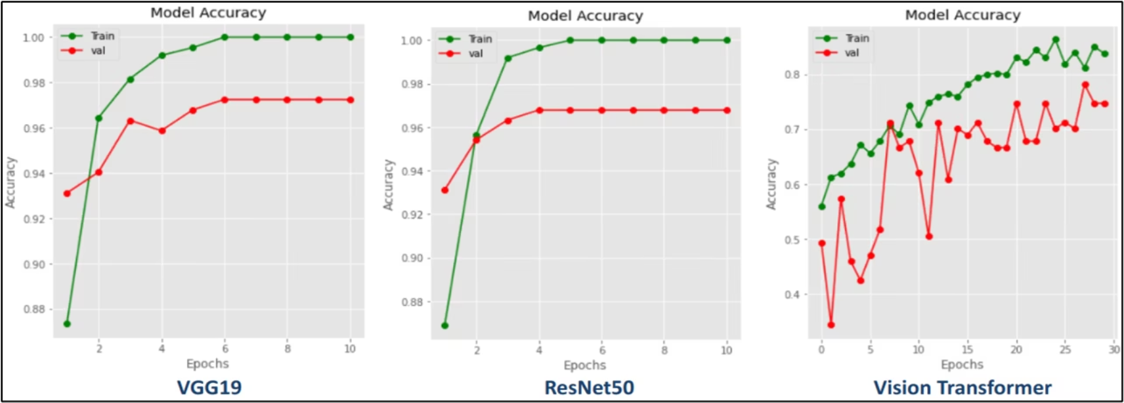
Accuracy vs Epoch without LBP

Slide 7
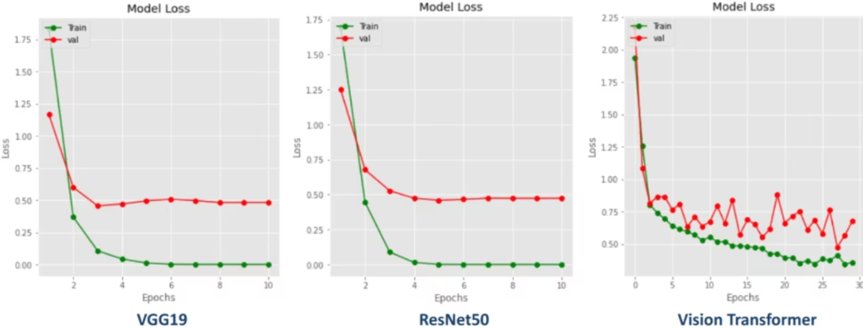
Loss vs Epoch without LBP
The graphs illustrate training loss and accuracy over epochs without feature extraction.
Observations show slower convergence and limited accuracy improvement.
Notes:
This slide shows the training loss and accuracy over epochs without using feature extraction. We can see that without feature extraction, the model converges more slowly and the accuracy improvements are limited. The slower convergence and limited accuracy gains indicate that feature extraction is an important component for improving the model's performance. Understanding these trends will help us make informed decisions about how to structure the model architecture and training process.

Slide 8
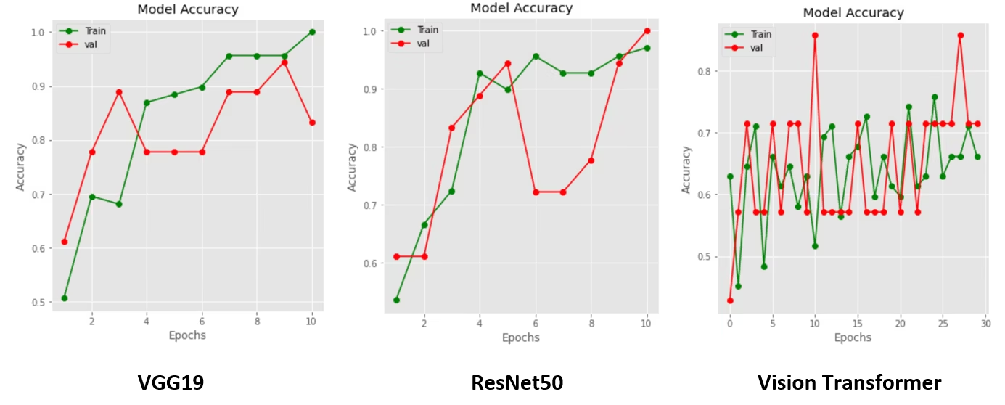
Accuracy vs Epoch with LBP
Loss decreases faster and accuracy improves using LBP features.
Indicates effective texture representation boosts model performance.

Slide 9
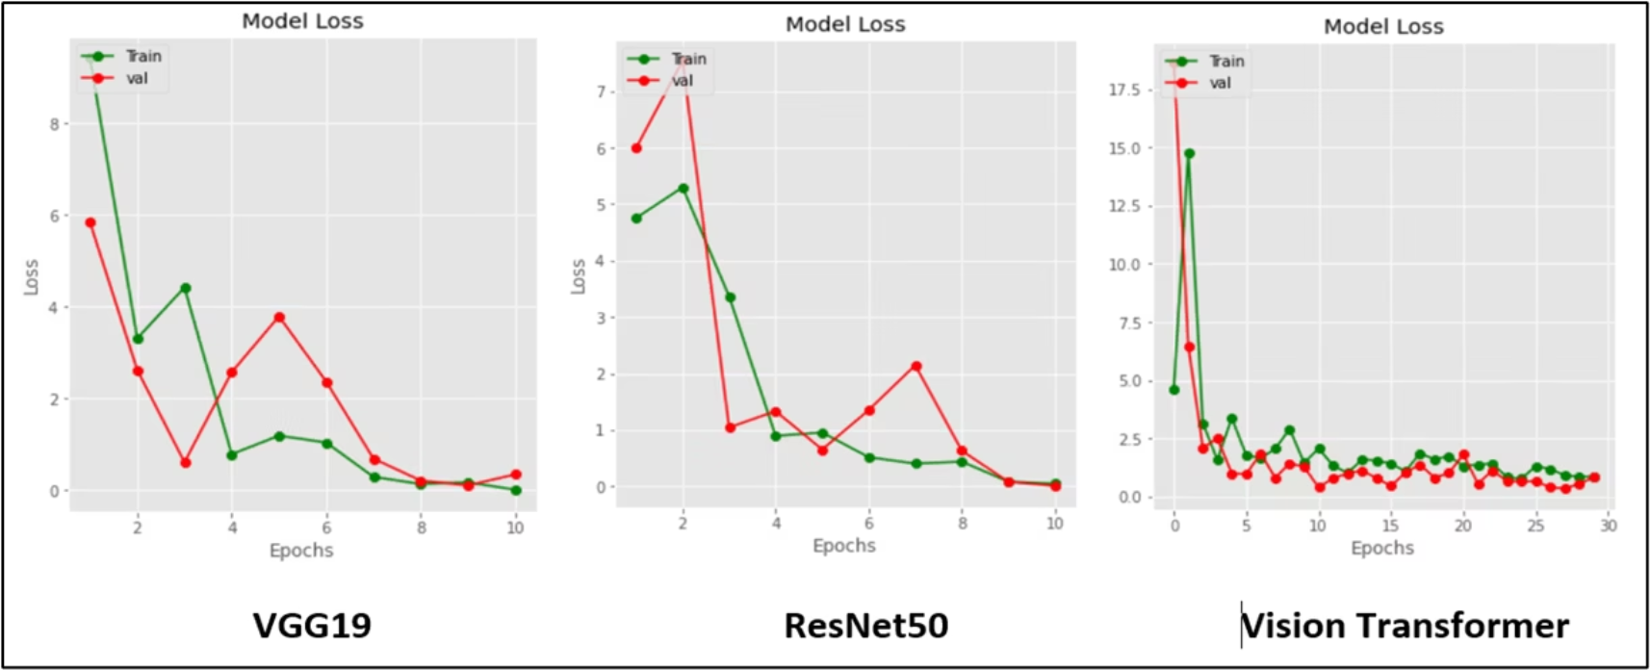
Loss vs Epoch with LBP

Slide 10
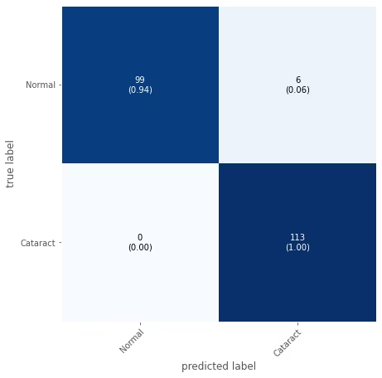
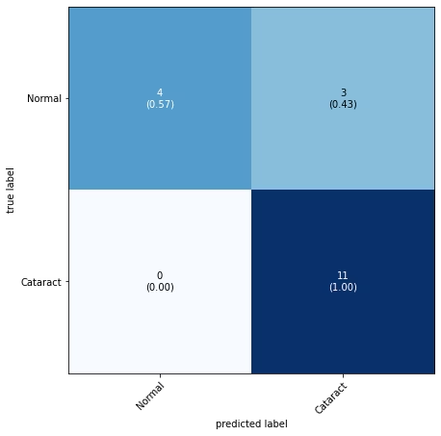

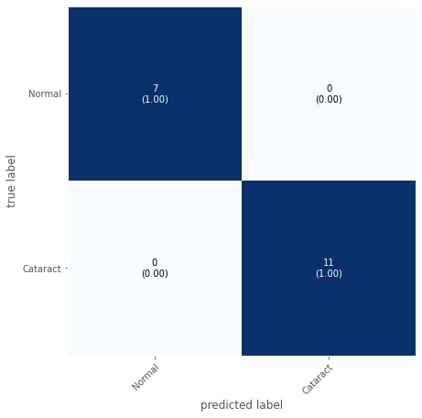
Confusion Matrices with and without LBP
Without LBP
With LBP
VGG19 and ResNet50 confusion matrices reveal baseline predictions.
VGG19 and ResNet50 confusion matrices improved classification accuracy is evident with LBP features.

Slide 11
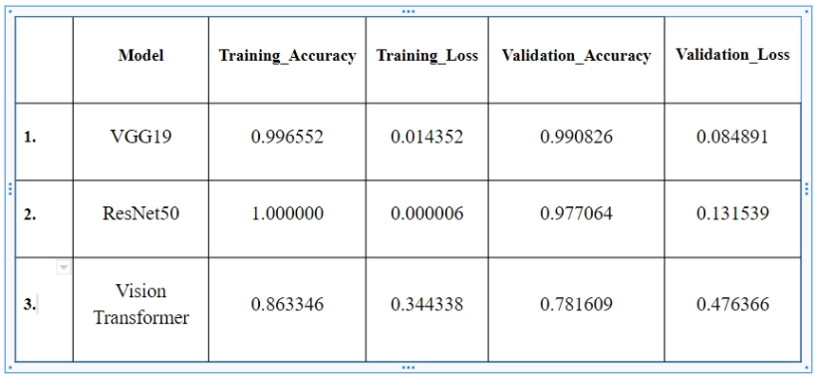
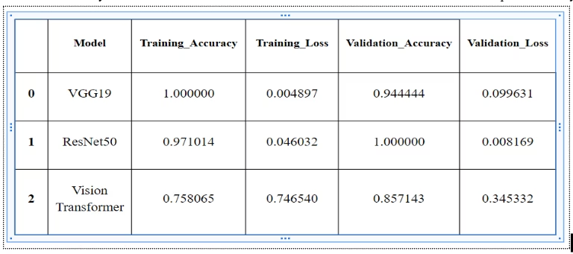
Result Comparison
Without LBP
With LBP
LBP integration significantly enhances model performance.
Models show moderate accuracy and loss values.

Slide 12

Novelty of Our Approach
Use of LBP feature extraction is a key innovation in this work.
Previously used techniques directly used the images without feature extraction.
But here we extracted the features using LBP(Local Binary Pattern) which helped in reducing the loss value.
The main idea behind LBP is to describe the neighborhood of image elements using binary codes. This method is usually used to study their local properties and identify the characteristics of individual parts of the image.
LBP encodes local texture as binary codes, improving model accuracy.
This approach reduces loss and computational complexity effectively.

